Slide 1

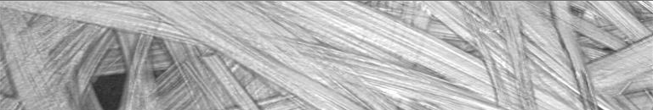

QualiFibre Qualification and Diagnosis of Carbon and Glass Fibre-Reinforced Composites with Non-Destructive Measurement Technologies
Workpackage 2
28/01/2015, Halle, Germany

Slide 2
Workpackage 2
Title: Testing, quality parameters and defects acquisition
Objectives:
Relevant defect parameters are identified
Reliable methods to insert defined defect structures into glass- and carbon-fibre materials have been implemented
Test samples have been designed and produced
Testing methods to recognize artificial defect structures have been established
Qualification method has been developed to classify defects properly and reliable
Concept of experimental set-up for multi sensor analysis has been developed

Slide 3
Task 2.1
Title: Definition of defect analysis, material parameter acquisition and qualification
Task Leader: EMPA
Goals:
Analysis of different kinds of defects
Categorisation of defects
Qualification of defects
Notes:
... that means:
1) WHAT are the relevant defects in selected industries / branches / products?
2) HOW can we detect them in a ...
- cheap,
- fast and
- reliable way?

Slide 4
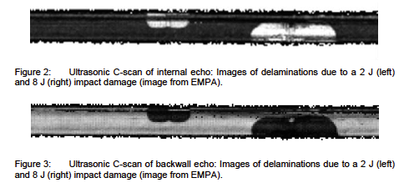
Task 2.1
Analysis of different kinds of defects (examples) ... using ultrasonic

Slide 5
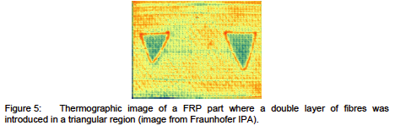
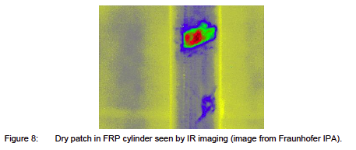
Task 2.1
Analysis of different kinds of defects (examples) ... using thermography

Slide 6
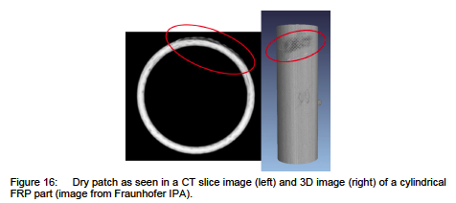
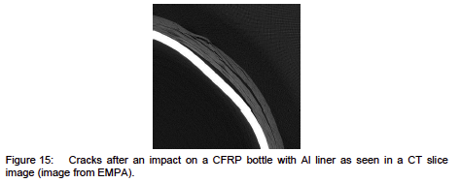
Task 2.1
Analysis of different kinds of defects (examples) ... using CT

Slide 7
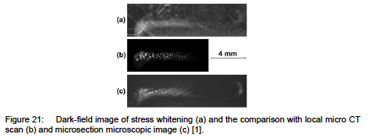
Task 2.1
Analysis of different kinds of defects (examples) ... using dark field

Slide 8
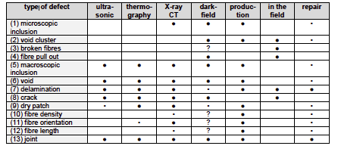
Task 2.1
Defect Structure Qualification and Characterization Method Matrix

Slide 9
Task 2.1: Did we reach our goals?
Goals:
Analysis of different kinds of defects
Categorisation of defects
Qualification of defects
✓
✓
✓
Notes:
... that means:
1) WHAT are the relevant defects in selected industries / branches / products?
2) HOW can we detect them in a ...
- cheap,
- fast and
- reliable way?

Slide 10
Task 2.2
Title: Development of adequate test parts and samples with defined defects. Elaboration of a test plan for specified parameter/data resampling
Task Leader: STW
Goals:
Development of test-part mould for production
Reproducible production of test-parts with defined defects
Elaboration of a test-plan for multi-sensor-data acquisition
Notes:
... that means:
1) WHAT are the relevant defects in selected industries / branches / products?
2) HOW can we detect them in a ...
- cheap,
- fast and
- reliable way?

Slide 11
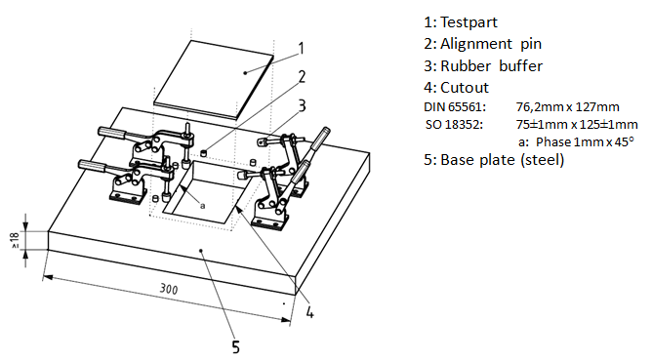
Task 2.2
The Mould for the test parts
I
Mould for test part manufacturing

Slide 12
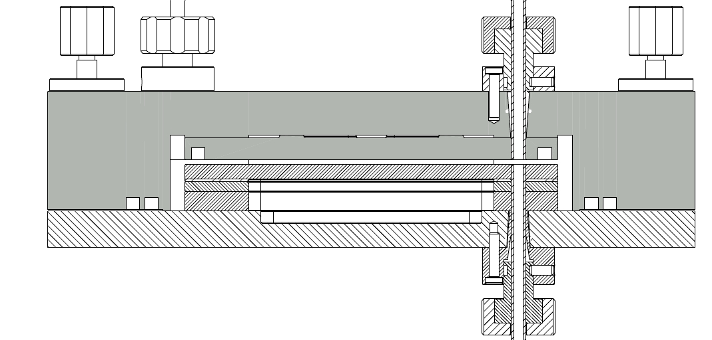
Task 2.2
The Mould for the test parts
Cross section of the mould for flat and 3D-test parts

Slide 13
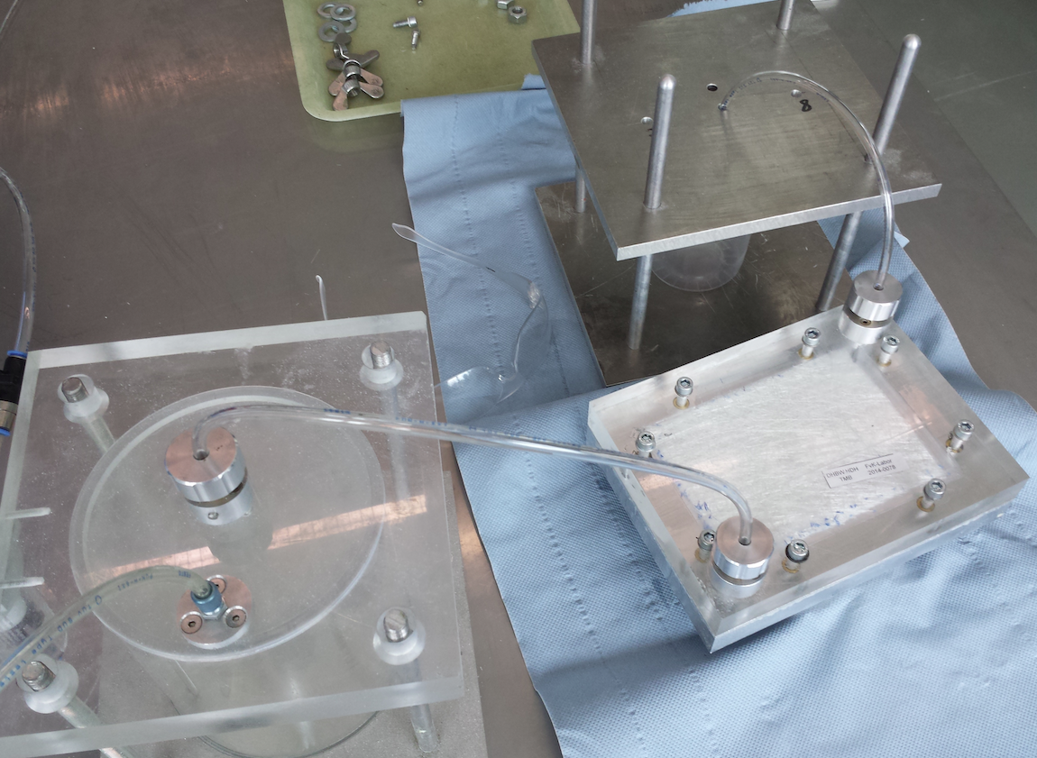
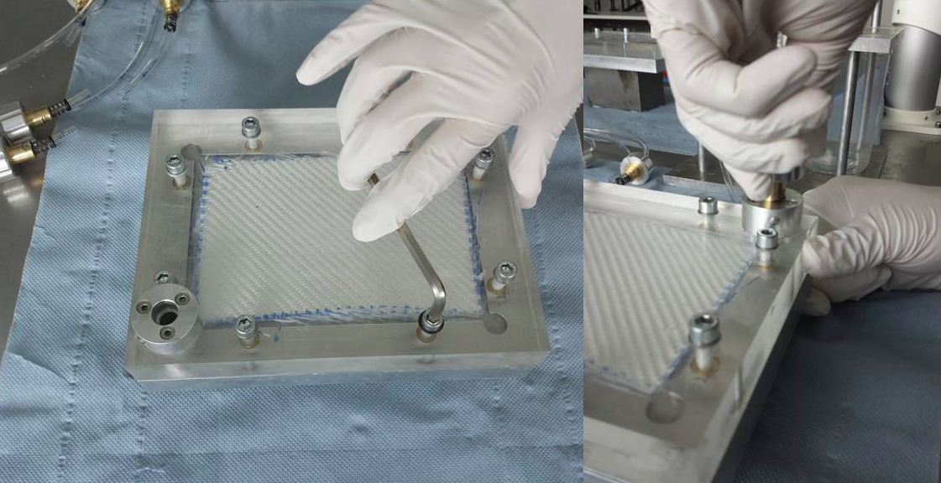
Task 2.2
The production of the Test parts

Slide 14
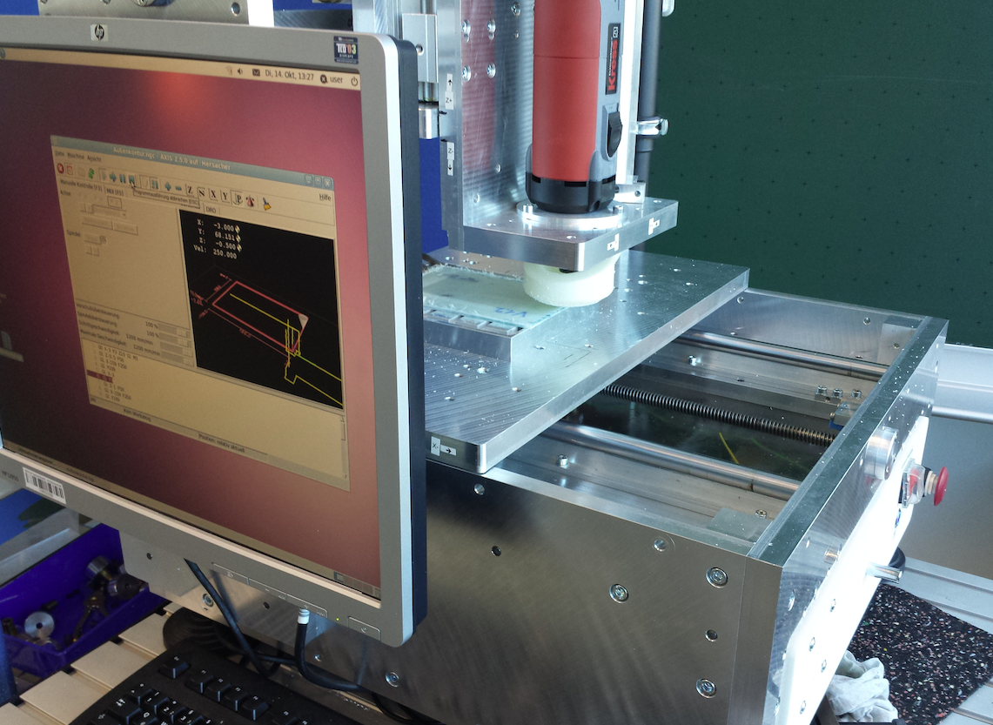
Task 2.2
The production of the Test parts – post-processing

Slide 15
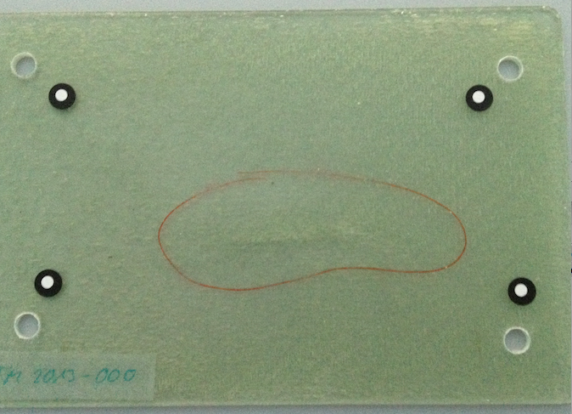
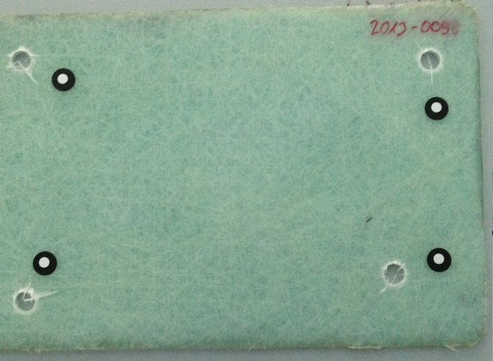
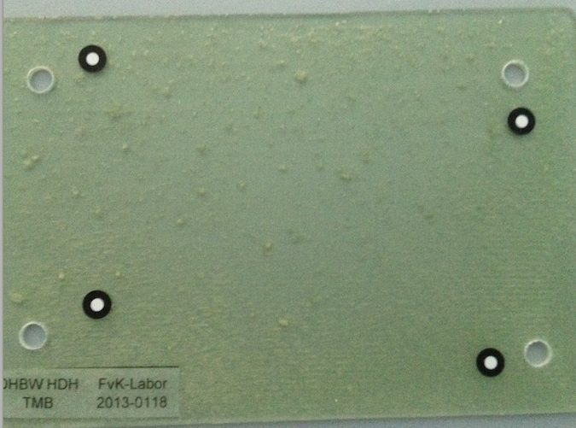
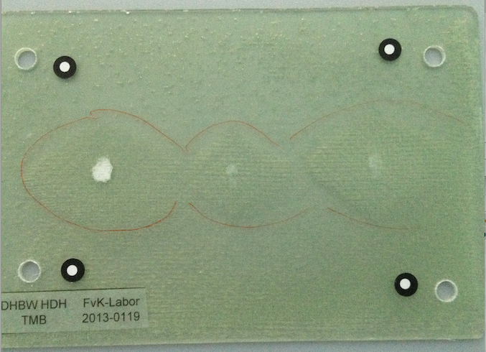
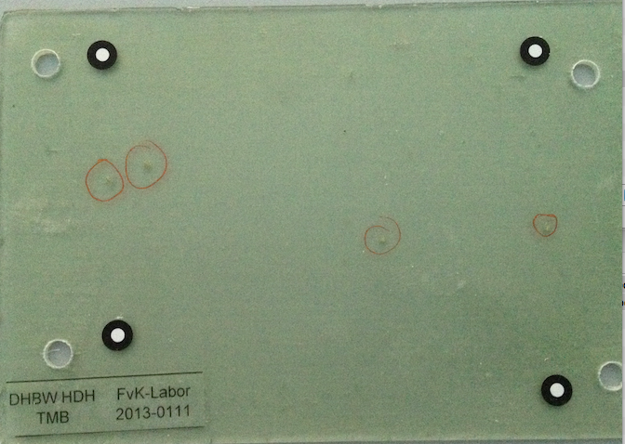
Task 2.2
Test parts with defined defects

Slide 16
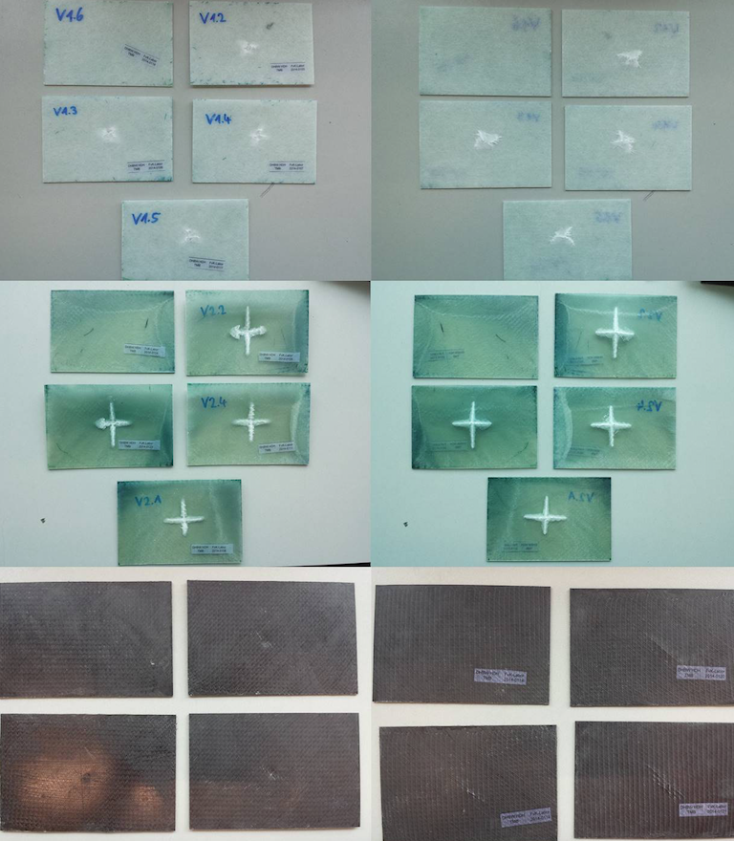
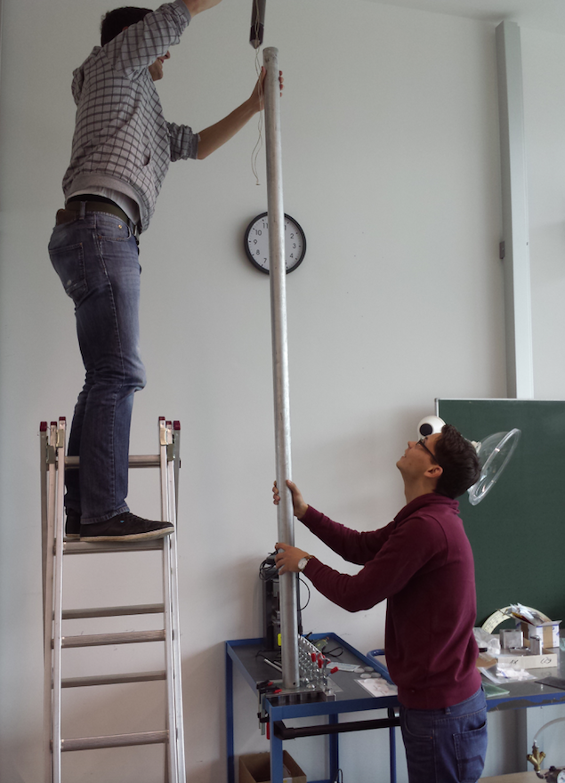
Task 2.2
Test parts – pre damaging

Slide 17
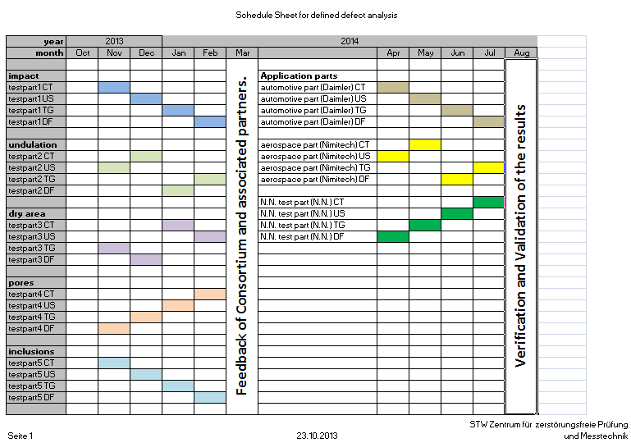
Task 2.2
Test plan
testparts with defined defects
different sensors of one kind (US or TG or CT ...)
tests regarding visibility, detectability, resolution, scan-time etc.

Slide 18
Task 2.2: Did we reach our goals?
Goals:
Development of test-part mould for production
Reproducible production of test-parts with defined defects
Elaboration of a test-plan for multi-sensor-data acquisition
✓
✓
✓

Slide 19
Task 2.3
Title: Development of the test plan for sensor type selection considering the different parameter/defect types and specification of the used sensors
Task Leader: STW
Goals:
design of a methodology of multi-sensor measurement equipment
development of a test plan, covering all relevant defect structures

Slide 20
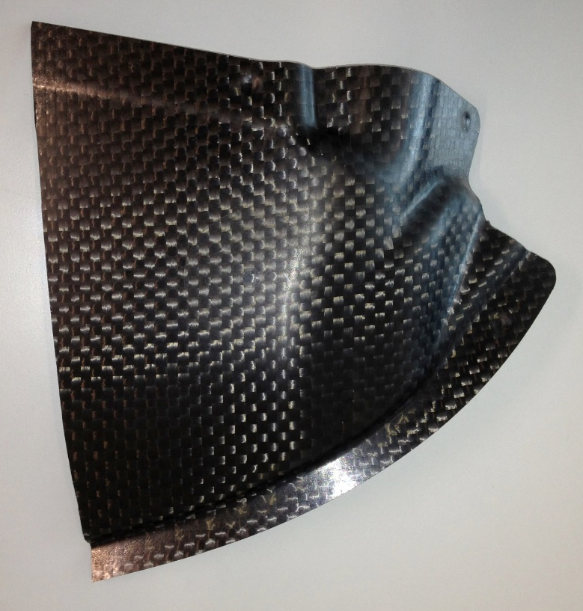
Task 2.3
End users test parts
trunk part from Daimler AG

Slide 21
Task 2.3
Test plan
End users test parts
Prove of concept tests
Performance tests to locate the optimization potential

Slide 22
Task 2.3: Did we reach our goals?
Goals:
design of a methodology of multi-sensor measurement equipment
development of a test plan, covering all relevant defect structures
✓
✓
Notes:
... that means:
1) WHAT are the relevant defects in selected industries / branches / products?
2) HOW can we detect them in a ...
- cheap,
- fast and
- reliable way?

Slide 23
Task 2.4
Title: On board overload sensing
Task Leader: STW
Goals:
analysis of possible technical solutions with regard of possible usability in field monitoring and status documentation of CRP/GRP objects

Slide 24
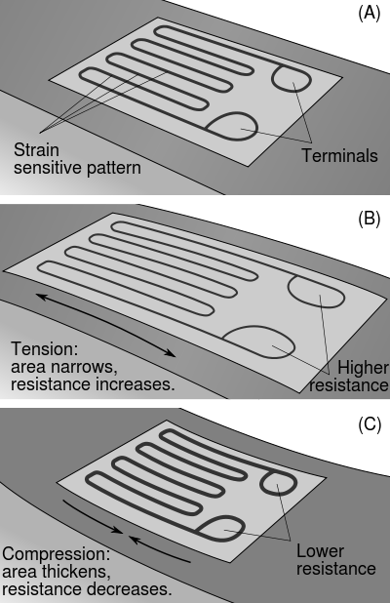
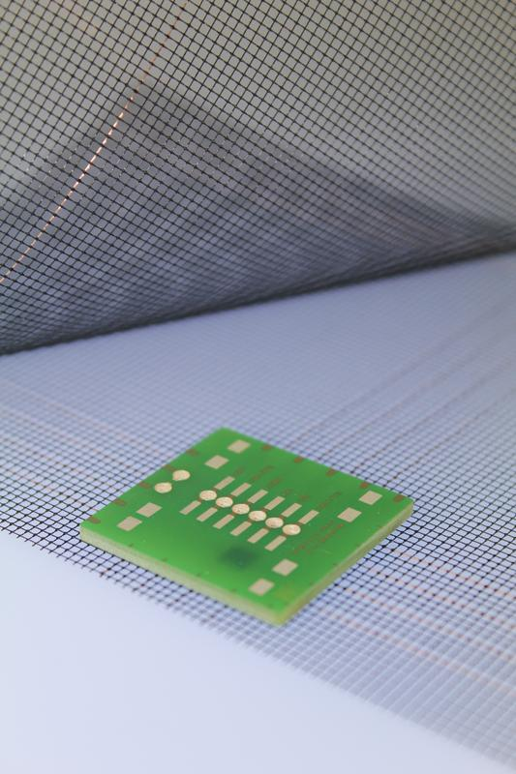
Task 2.4
Strain gauges
Quelle: http://upload.wikimedia.org/wikipedia/commons/thumb/c/c3/StrainGaugeVisualization.svg/400px-StrainGaugeVisualization.svg.png
Quelle: Fraunhofer IZM (idw) http://www.extremnews.com/berichte/wissenschaft/2ea51411dfa71ee/d2ed1411dfa7221/

Slide 25
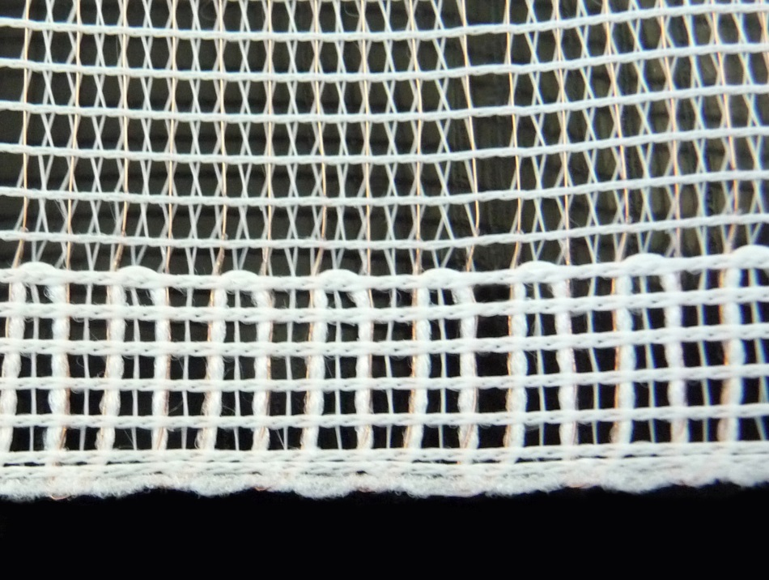
Task 2.4
Powersense and structure-borne-noise-/impact-noise-analysis
Quelle: SEFAR PowerSense, Quelle: Sefar AG, CH http://www.sefar.com/data/docs/en/7281/SF-Smart-Fabrics-PowerSens-07.jpg?variant=44253
Quelle:
ATZ - Automobiltechnische Zeitschrift Ausgabe 02/2008 Seite 160-165, Autor(en): Dipl.-Ing. (FH) Marinus Luegmair, Dipl.-Ing. (FH) Lucas Oestreicher

Slide 26
Task 2.4: Did we reach our goals?
Goals:
analysis of possible technical solutions with regard of possible usability in field monitoring and status documentation of CRP/GRP objects
BUT: further investigation an d research necessary!
Especially: Production of test parts.
And also: Systematic analysis of usability during complete lifetime of a product.
To be continued!
✓
Notes:
... that means:
1) WHAT are the relevant defects in selected industries / branches / products?
2) HOW can we detect them in a ...
- cheap,
- fast and
- reliable way?

Slide 27
Task 2.5
Title: Conceptual development of experimental set-up for all sensors and application requirements
Task Leader: STW
Goals:
conceptual definition of multi-sensor equipment

Slide 28
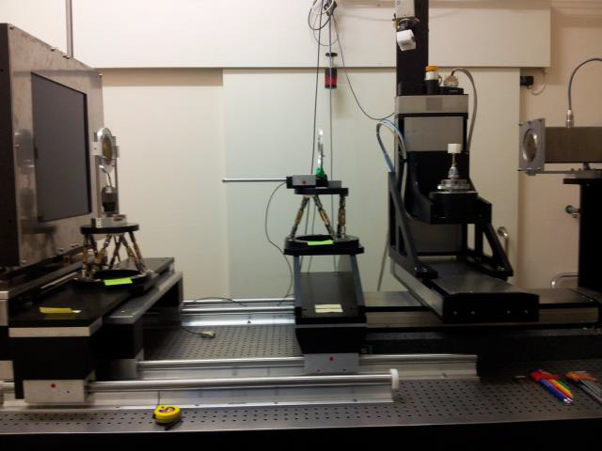
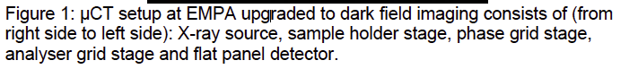
Task 2.5
Conceptual hardware set-up dark field / CT at EMPA

Slide 29
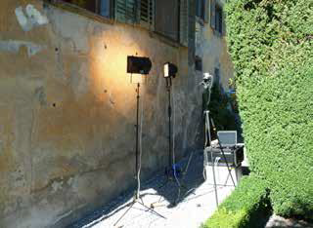
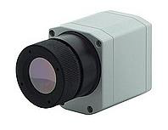
Task 2.5
Conceptual hardware set-up thermography at Winterthur Instruments

Slide 30
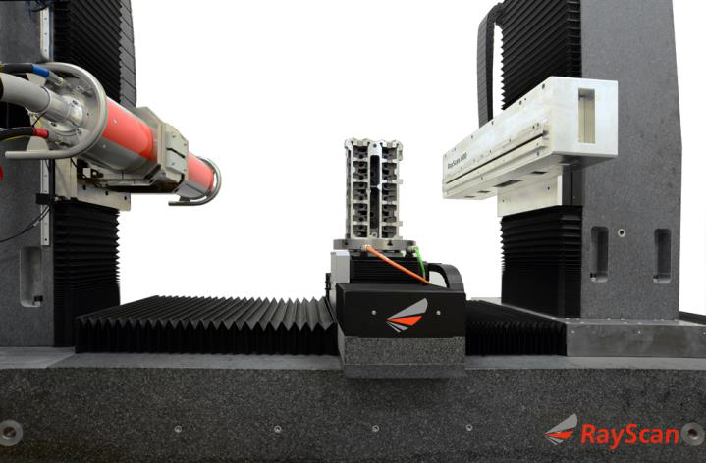
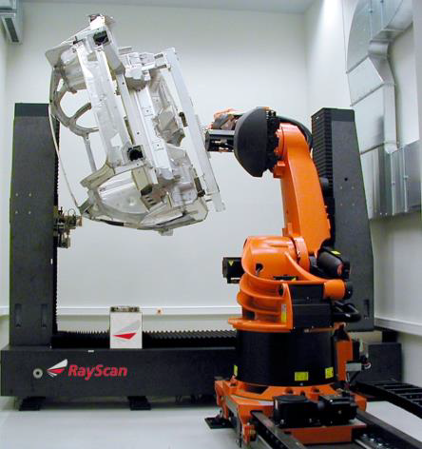
Task 2.5
Conceptual hardware set-up CT at Rayscan

Slide 31
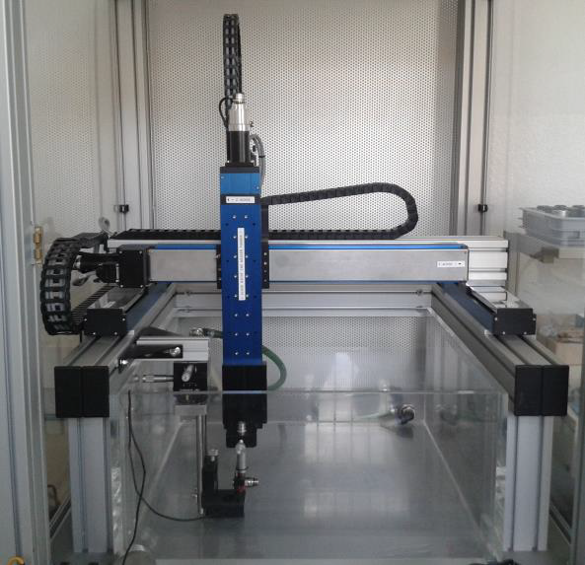
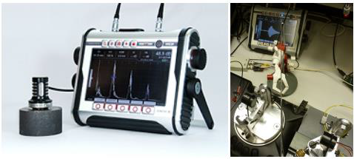
Task 2.5
Conceptual hardware set-up ultrasonic at Sonotec

Slide 32
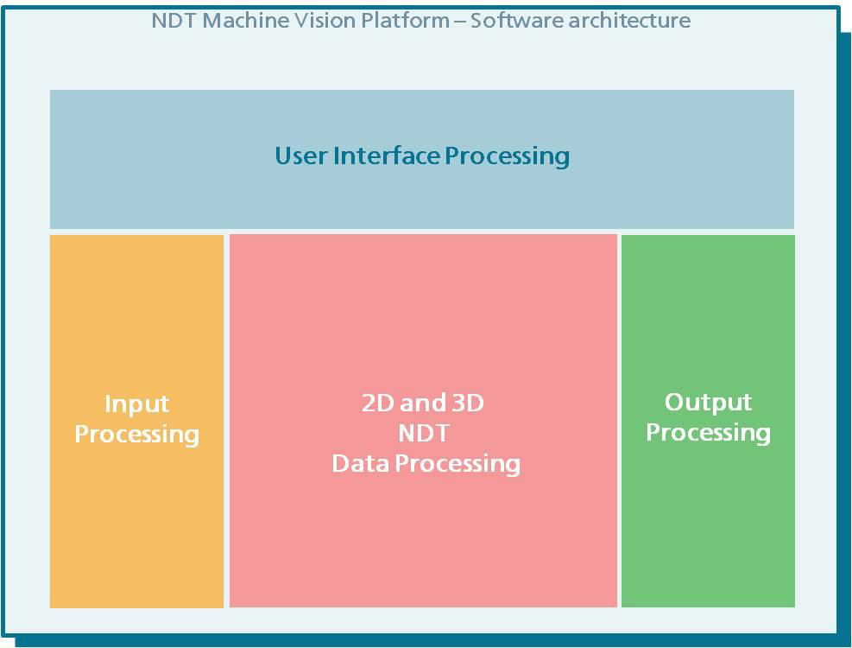
Task 2.5
Conceptual software set-up
→ Details will be presented in WP3

Slide 33
WP 2: Conclusion
Did we reach the objectives of our Workpackage?
Relevant defect parameters are identified
Reliable methods to insert defined defect structures into glass- and carbon-fibre materials have been implemented
Test samples have been designed and produced
Testing methods to recognize artificial defect structures have been established
Qualification method has been developed to classify defects properly and reliable
Concept of experimental set-up for multi sensor analysis has been developed
✓
✓
✓
✓
✓
✓

